Slide 1

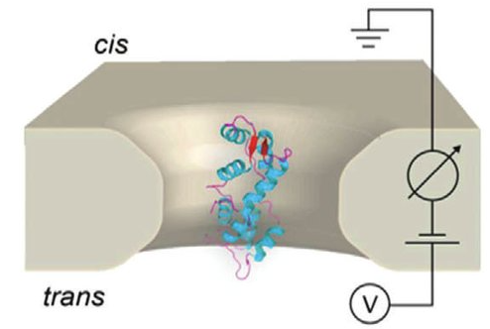
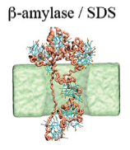
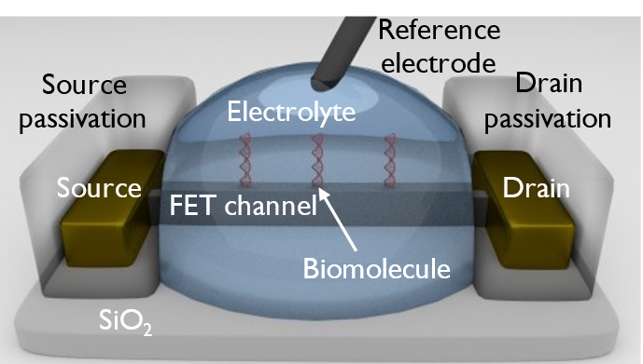
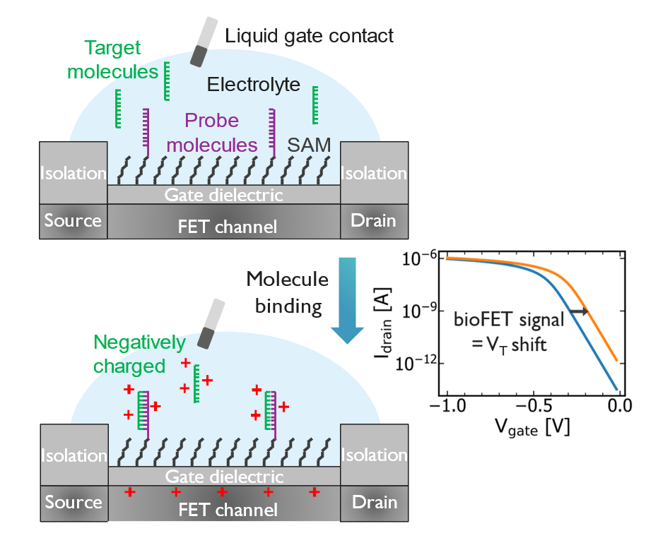
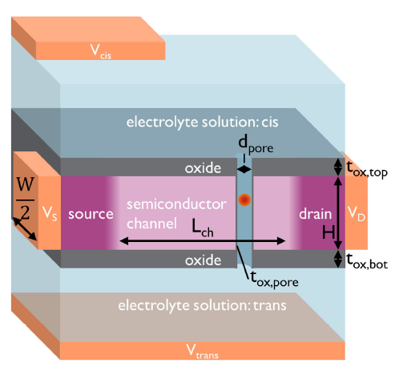
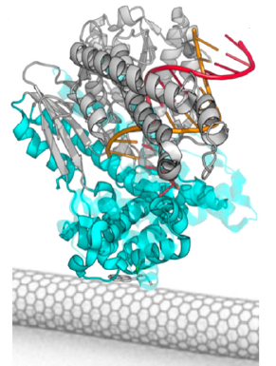



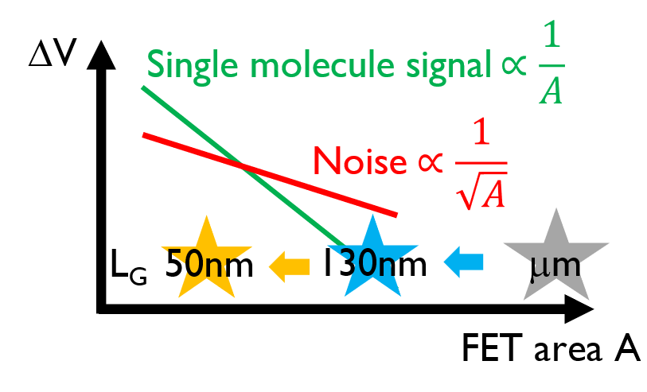
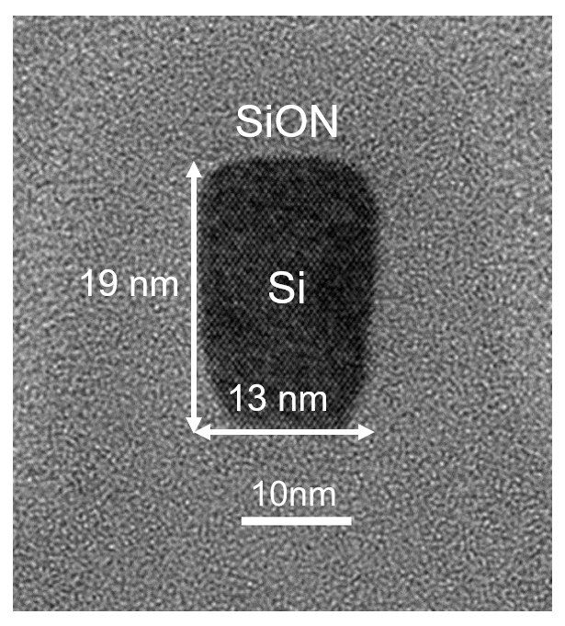
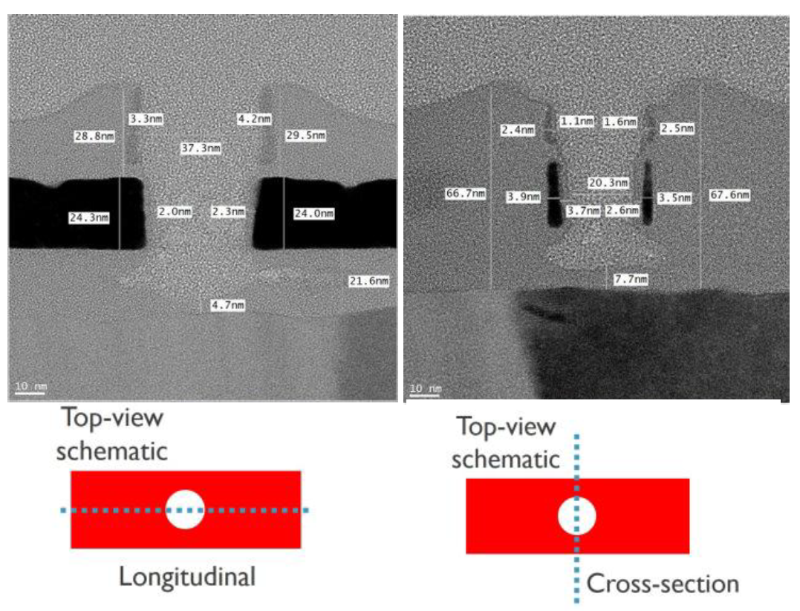
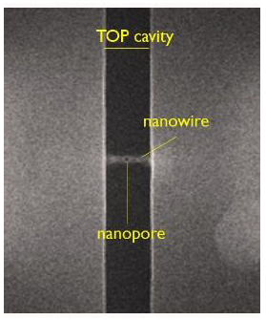
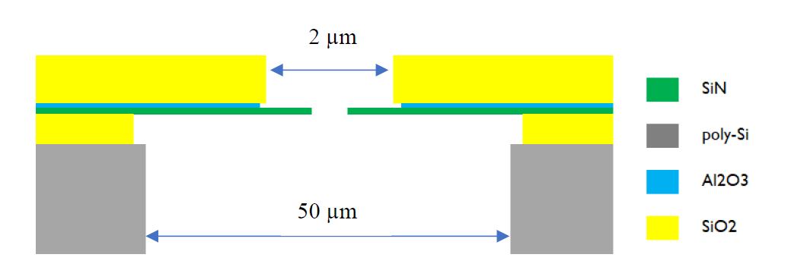
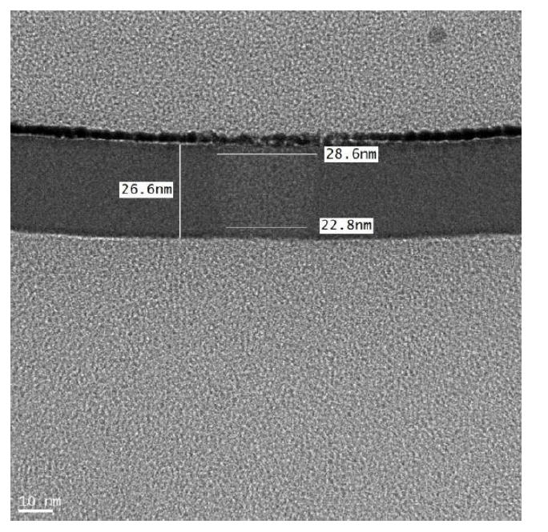
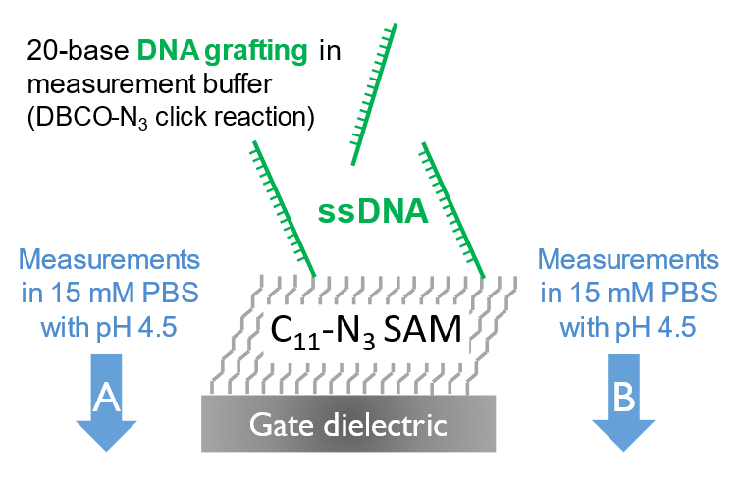
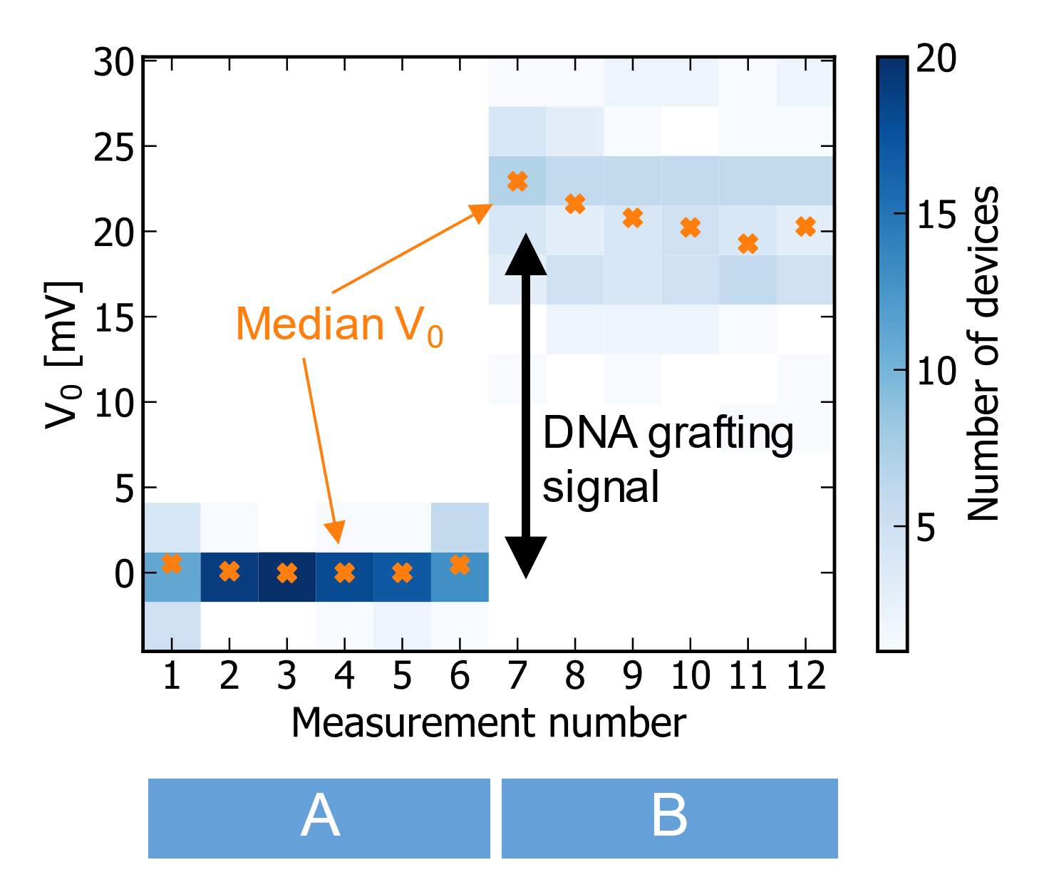
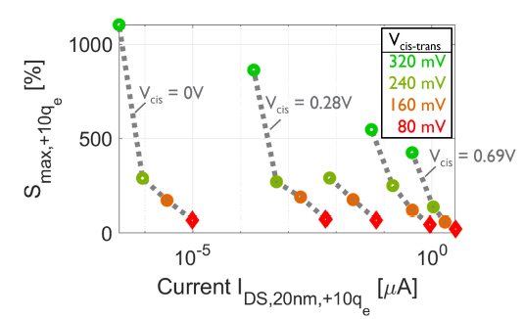
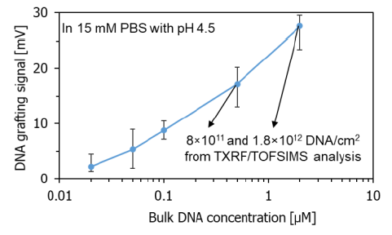

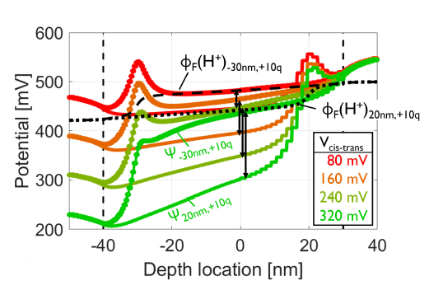
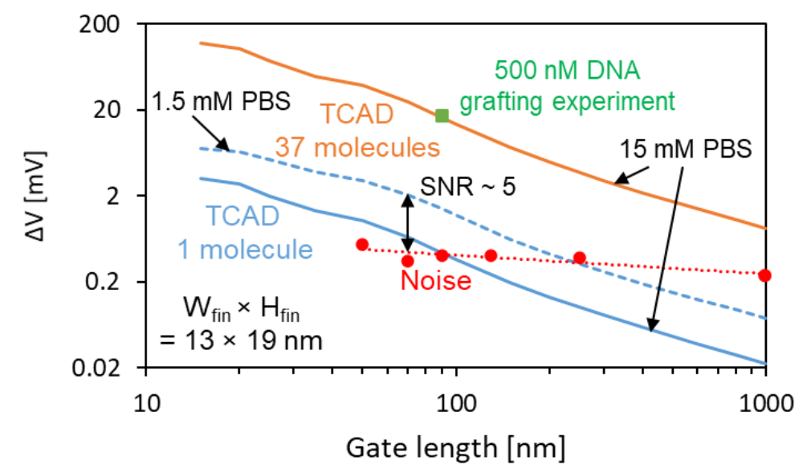
The Nanopore Field Effect Transistor (FET) for Protein Analysis
Koen Martens^{1,2}, David Barge^{1,2}, Colin Locquart^{1,2}, Sybren Santermans¹, Lijun Liu^{1,2}, Jacobus Delport^{1,2}, Bert Du Bois¹, Anne Verhulst^{1,2}, Simone Severi¹, Pol Van Dorpe^{1,2}
Nanopore technology has revolutionized DNA sequencing, and nascent nanopore-based technology breakthroughs may be anticipated to lead to revolutions in protein analysis.
Present-day nanopore tech relies on the recording of very small (∼pA-nA) ionic currents. Such low currents limit recording bandwidth and impose a translocation speed limit.
Single molecule proteomics-on-chip massively parallel system vision
Protein/biopolymer sample
Proteomics-on-chip demands single-molecule
Achilles heel of single-molecule fluorescence methods: limited throughput, difficulties to improve dynamic range vs. MS
Sense freely translocating molecules at high bandwidth ⇒ high throughput, potential dynamic range 10⁸-10¹² vs. MS 10⁵
...
101100110
sensor device
10³-10⁶ devices/chip
protein identity
10³-10⁶ molecules/s
The best-of-both-worlds combination of nanopores and bioFETs:
Solid-state nanopore
+
bioFET
=
Nanopore FET
6.5nm
DNA polymerase I
Klenow Fragment
Restrepo-Perez et al.
Nanoscale 2017
Olsen et al.
JACS 2013
A nanopore wrapped by a nanoscale field-effect transistor (FET). The FET senses single molecules translocating through the pore
Translocating molecule modulates the recorded ionic current passing through pore
Molecule docks close (1-10nm) to FET surface. Molecule’s charge modulates channel charge and FET current
Chemically robust (vs. biopore)
SiO₂ and/or Si₃N₄ surfaces
High molecule throughput
In theory up to millions/s
not same as molecules detected
Low ion current (pA-nA), low bandwidth(1kHz-1MHz), cannot sense quickly translocating molecules
Difficult to integrate on chip
High spatial resolution toward sequencing (vs. biopore) undemonstrated
Chemically robust
SiO₂ and/or Si₃N₄ surfaces
Low molecule throughput
surface capture/docking, enzymatic
High FET current, high bandwidth, sense very fast changes
μA currents, 1-100MHz bandwidth or more
Can be massively integrated on chip
up to billions per chip
Spatial resolution (e.g. linked to enzyme) undemonstrated
Chemically robust (vs. biopore)
High molecule throughput
As in nanopore
High FET current, high bandwidth
senses both resistive divider effect and/or charge
Can be massively integrated on chip
Millions to billions per chip
High spatial resolution undemonstrated
The NPFET promises:
higher bandwidths, breaking of nanopore speed limit
easy integration into large arrays
⇒ orders of magnitude greater molecular sensing throughput
Imec’s nanopores, bioFETs and nanopore FETs
Nanopore
BioFET
World’s smallest bioFETs
down to 50 nm gate length
Nanopore FET
Modeling work with dedicated nanoelectronics-nanofluidics simulator: Major sensitivity boost obtained when biasing NPFET in the exponentially sensitive subthreshold regime
Schematic cross-section of membrane and pore
Top view SEM
Thick 0.75um oxide
For low capacitance
bioFET
TEM cross-section
TEM
cross-section
of nanopore
milestone of fabrication and characterization of the NPFET.
lithography based nanopore formation and opening in the nanowire channel is realized, with nanopore diameter down to 20-30 nm, silicon channel as thin as 4 nm.
The NPFET has excellent electrical characteristics
Clear signal of ~ 17 mV for 500 nM DNA = 8x10¹¹ DNA/cm⁻² (TXRF)
~ 37 molecules for smallest measured device: (13+2×19)×90 nm²
Mass-manufacturable, lithographically patterned 25nm diameter nanopores with low capacitance membranes for increased bandwidth and signal-to-noise ratio
Modeled (TCAD) single-molecule outlook
Sub-70 nm long FETs show potential for single-molecule detection
1.5 mM PBS: SNR > 5
Santermans et al.
IEDM 2020
Verhulst et al. IEEE Sensors 2022

